Slide 1
AIAA 5047 Responsible AI 2025 Fall
Sihong Xie, AI Thrust, Information Hub
Lecture 4
W2 201, 9-11:50 AM F

Slide 2
Agenda
Gradient-based method for explaining LLM.
pros: easy to implement; intuitively understandable.
cons: not applied to commercial LLMs or larger ones; cannot enter the internal of LLM.
Blackbox explanation of LLM.
pros: easy to implement (just asking!) and understand.
cons: the output explanations may not reflect what its thinking process.
Whitebox (mechanical) explanation of LLM
pros: get into the internal of an LLM.
cons: complicated to implement and evaluate.

Slide 3
Gradient-based explanations of LLMs
Gradient
The gradient of the prediction with respect to the input can be understood as the sensitivity of the prediction to changes in the input.
The absolute value of the gradient represents the importance of the input.
Output
Gradients
Input
The pipeline for gradient-based explanations of LLMs
LLM forward
Back
Propagation
Select according to the gradients
Input: Question
Output:
Answers
Gradients：
Input token
Important tokens

Slide 4
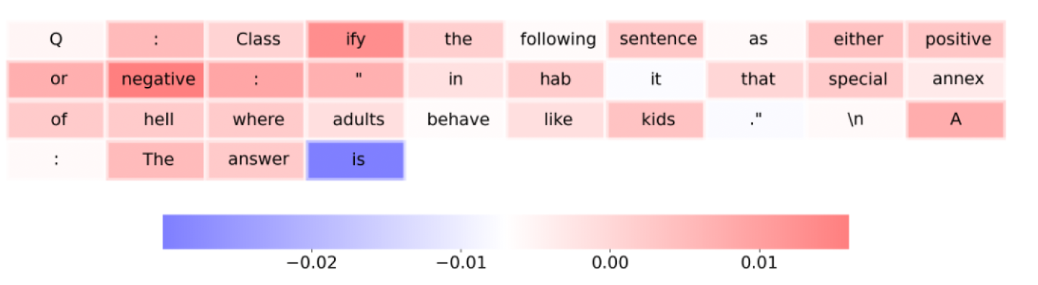
Gradient-based explanations of LLMs
The authors employ gradient-based feature attribution methods to generate saliency scores that quantify the influence of input tokens on model outputs.
Original question: Classify the following sentence as either positive or negative: “inhabit that special annex of hell where adults behave like kids.”
Standard prompting: Q: Classify the following sentence as either positive or negative: “inhabit that special annex of hell where adults behave like kids.” A: The answer is _____ (negative*)
A bluer/redder color denotes a more negative/positive influence toward the model’s output
Wu S, Shen E M, Badrinath C, et al. Analyzing chain-of-thought prompting in large language models via gradient-based feature attributions[J]. ICML workshop 2023

Slide 5
Gradient-based explanations of LLMs
They examine several open-source LLMs to determine whether CoT prompting alters the relative importance assigned to specific input tokens.
CoT prompting (Chain-of-Thought prompting) is a prompting technique. Instead of asking a large language model (LLM) to give the final answer directly, the model is encouraged to first generate step-by-step reasoning (a chain of thought) before providing the answer.
Example:
Standard prompting: Q: What is 37 + 48? A: 85
CoT prompting: Q: What is 37 + 48? A: First, add 30 and 40 to get 70. Then add 7 and 8 to get 15. Finally, 70 + 15 = 85. So the answer is 85.
Wu S, Shen E M, Badrinath C, et al. Analyzing chain-of-thought prompting in large language models via gradient-based feature attributions[J]. ICML workshop 2023

Slide 6
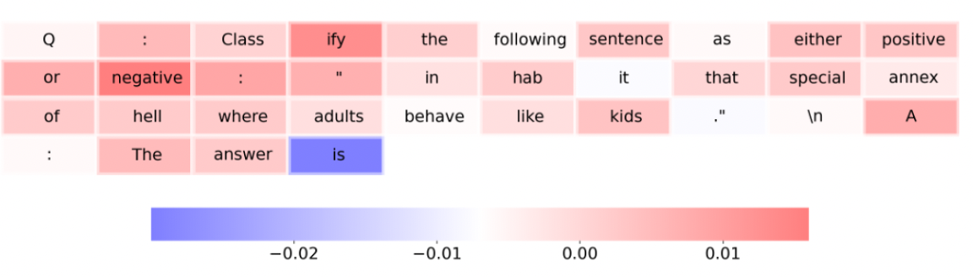
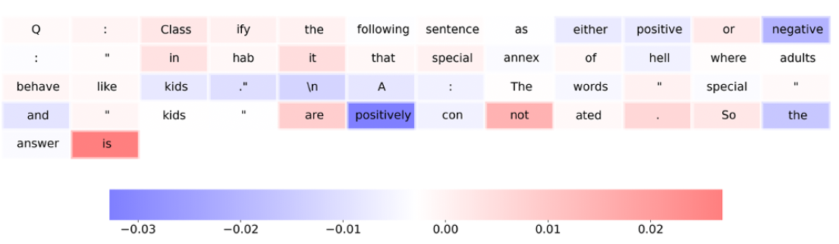
Gradient-based explanations of LLMs
They compute saliency scores for input tokens under both standard and CoT prompting across multiple Q&A datasets.
Example:
CoT prompting:
Q: Classify the following sentence as either positive or negative: “inhabit that special annex of hell where adults behave like kids.”
A: The words “special” and “kids” are positively connotated. So the answer is negative
Standard prompting:
Q: Classify the following sentence as either positive or negative: “inhabit that special annex of hell where adults behave like kids.”
A: The answer is negative
Using standard prompting, the tokens immediately preceding the answer have the strongest saliency scores, whereas with CoT prompting, although the numerical magnitudes of saliency scores are all decreased, earlier tokens are relatively more significant.
Wu S, Shen E M, Badrinath C, et al. Analyzing chain-of-thought prompting in large language models via gradient-based feature attributions[J]. ICML workshop 2023

Slide 7
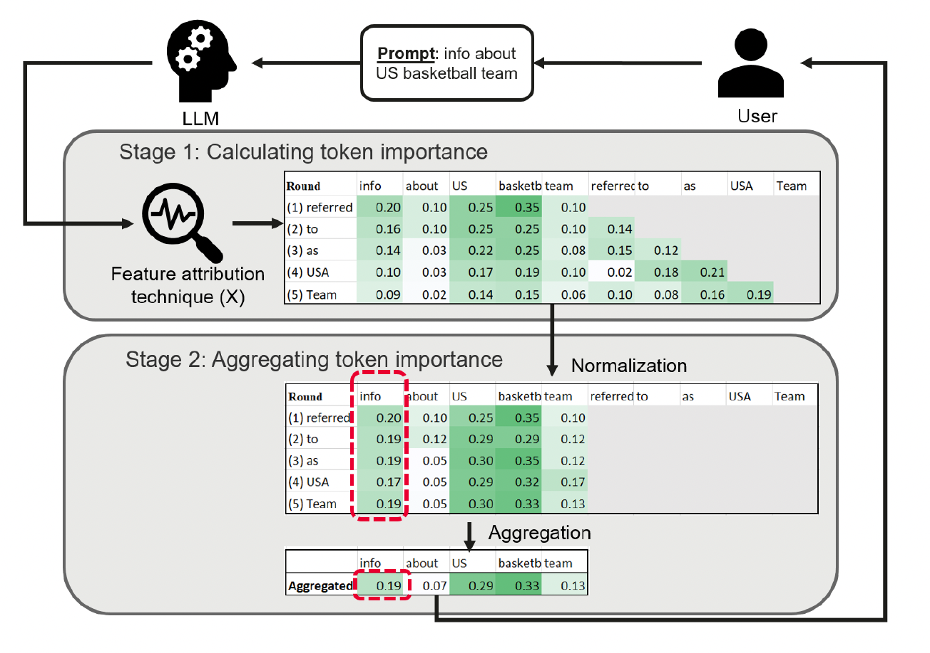
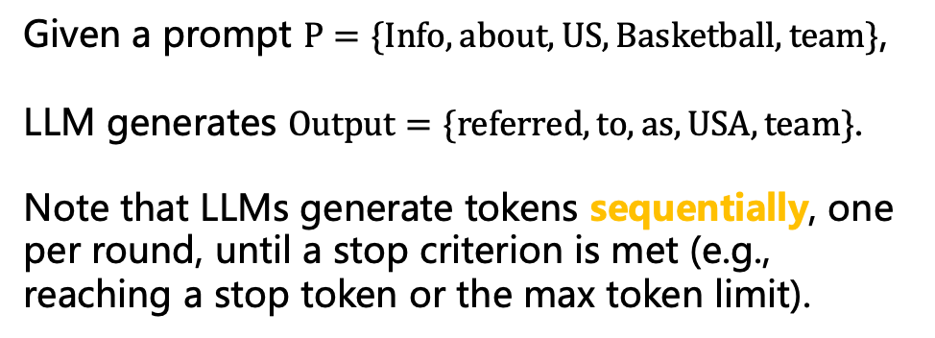
Gradient-based explanations of LLMs
Aggregation-based token-level explanations for multiple output tokens.
Stage 1: The authors use existing a local explanation method (Integrated Gradients) to compute the importance score of prompt tokens across multiple rounds of generation.
Stage 2: the token importance scores from all rounds are aggregated, representing the cumulative importance of prompt tokens across the entire sequence.
Given a prompt $P=\{Info,about,US,Basketball, team\}$,
LLM generates $Output=\{referred,to,as,USA,team\}$.
Note that LLMs generate tokens sequentially, one per round, until a stop criterion is met (e.g., reaching a stop token or the max token limit).
Dong X, Wang S, Lin D, et al. Promptexp: Multi-granularity prompt explanation of large language models[J]. arXiv preprint arXiv:2410.13073, 2024.

Slide 8
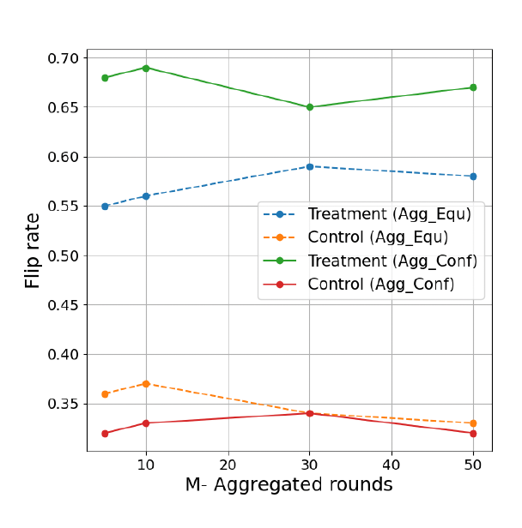
Gradient-based explanations of LLMs
The authors propose two weighting schemes in stage 2, equal weighting and confidence weighting.
equal weighting: the importance scores from all sampled rounds are treated equally.
confidence weighting: it assigns higher weights to rounds where the model is more confident in its predictions
This figure shows the impact of the number of sampled rounds (M) on aggregation-based methods.
Flip rate measures how often the output changes when important tokens are perturbed (counterfactual).
The treatment perturbs the most important tokens identified by the explanation method, while the control perturbs the least important tokens.
AggConf (confidence weighting) outperforms AggEqu (equal weighting), offering more stable and effective explanations.
Dong X, Wang S, Lin D, et al. Promptexp: Multi-granularity prompt explanation of large language models[J]. arXiv preprint arXiv:2410.13073, 2024.

Slide 9

Perturbation-based explanations of LLMs
The motivation for perturbation-based explanations of LLMs
Mask
Input
model
Prediction={dog，cat}
The pipeline for perturbation-based explanations of LLMs
Masking algorithm
LLM
Output
Explanation
Input
Image Source: https://www.facebook.com/520pets/
Kang J S, Butler L, Agarwal A, et al. Spex: Scaling feature interaction explanations for llms[J]. arXiv preprint arXiv:2502.13870, 2025.

Slide 10
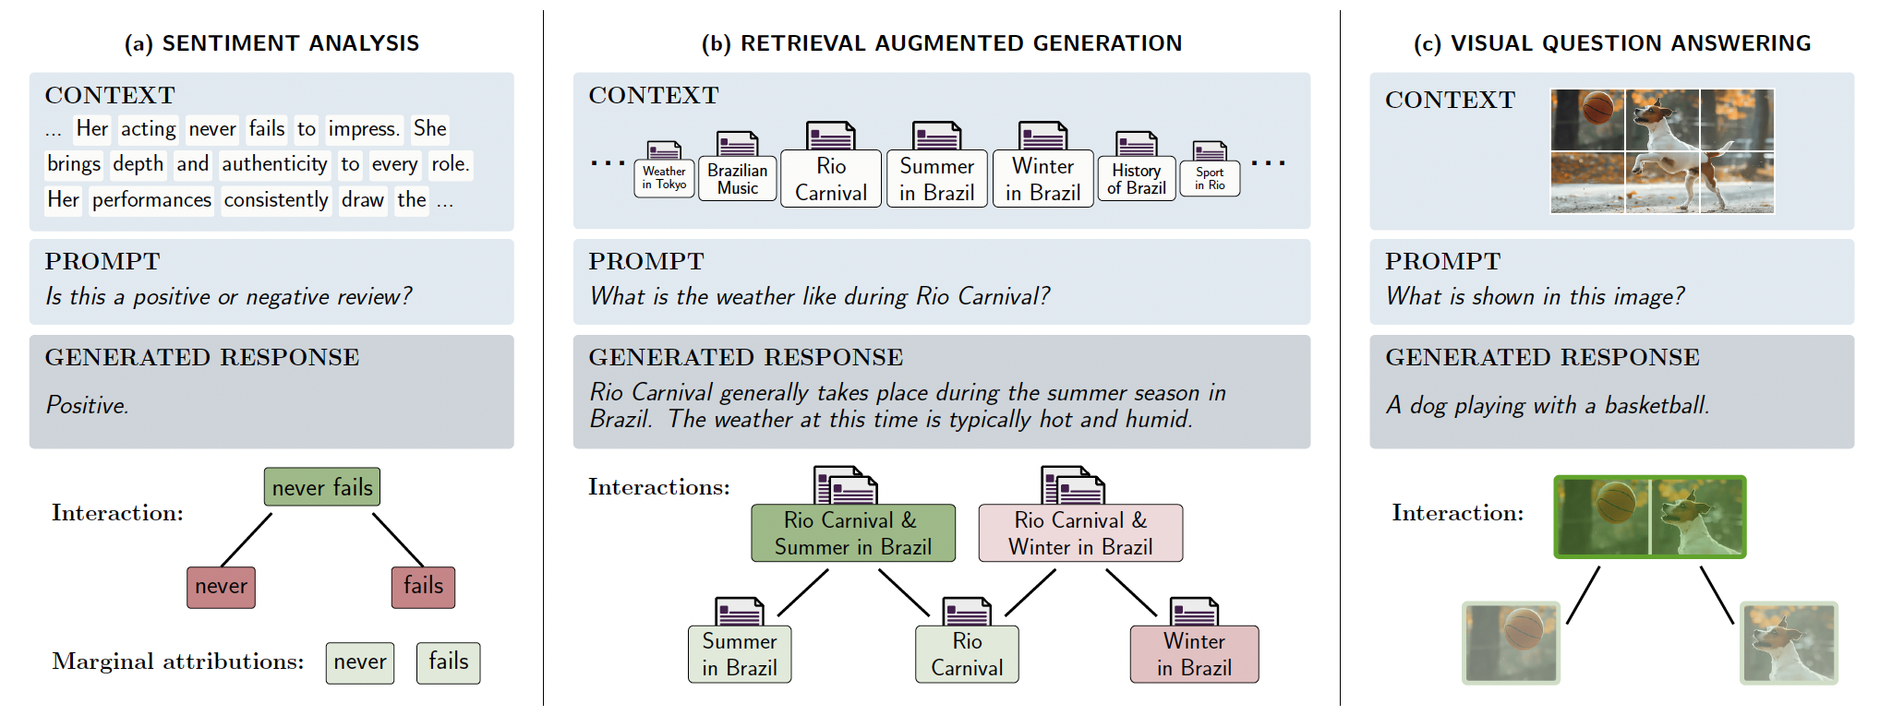
Perturbation-based explanations of LLMs
Motivation: LLM outputs are often driven by a small number of sparse interactions between inputs
Kang J S, Butler L, Agarwal A, et al. Spex: Scaling feature interaction explanations for llms[J]. arXiv preprint arXiv:2502.13870, 2025.

Slide 11
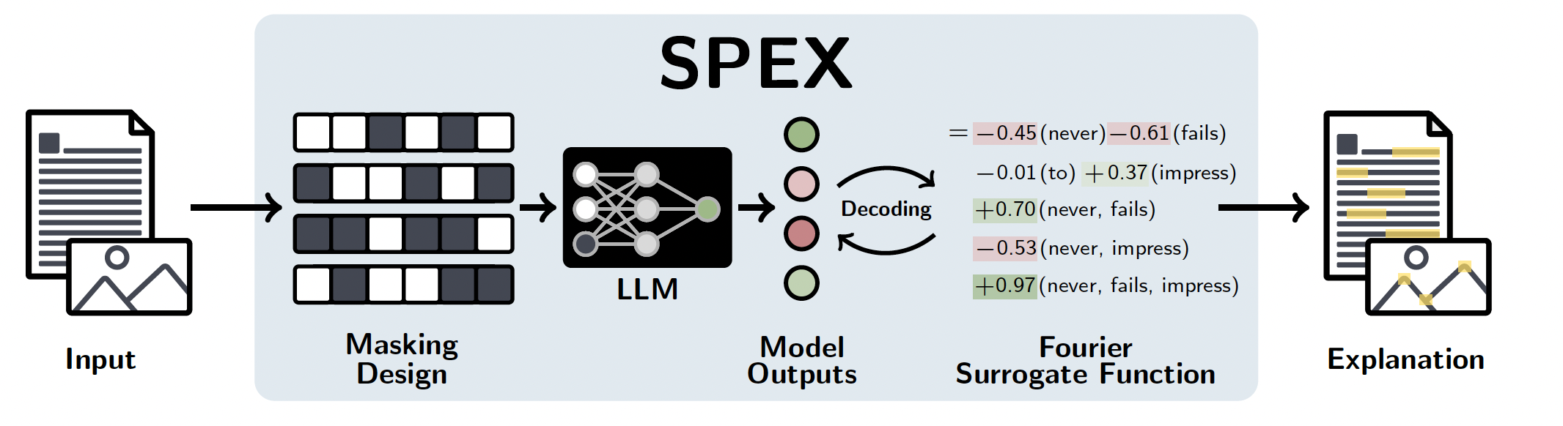
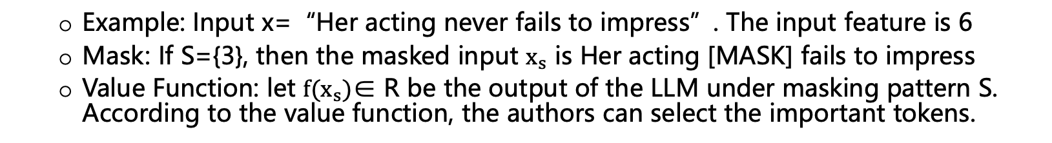
Perturbation-based explanations of LLMs
The framework of this paper.
Example: Input x=“Her acting never fails to impress”. The input feature is 6
Mask: If S={3}, then the masked input $x_{s}$ is Her acting [MASK] fails to impress
Value Function: let $f(x_{s})$∈ R be the output of the LLM under masking pattern S. According to the value function, the authors can select the important tokens.
Using Value Function directly has two problems:
If the number of features is n, there are $2^{n}$ possible subsets, which makes l enumeration infeasible.
The authors are interested not only in the marginal contribution of individual features, but also in feature interactions
Kang J S, Butler L, Agarwal A, et al. Spex: Scaling feature interaction explanations for llms[J]. arXiv preprint arXiv:2502.13870, 2025.

Slide 12
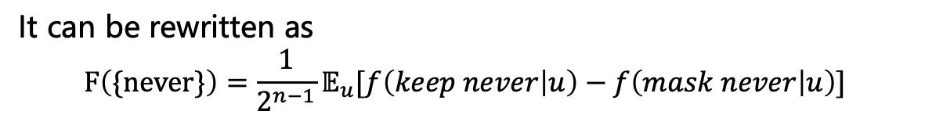

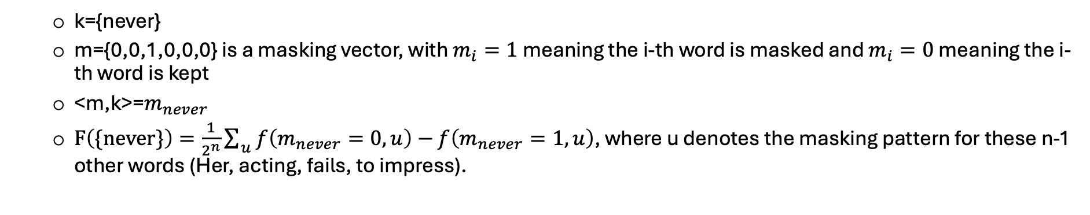
Perturbation-based explanations of LLMs
Thus, the authors introduce the Boolean Fourier transform to expand value function onto an orthogonal basis. The Fourier coefficient for feature interactions indicates their weight in explaining the LLM output.
Fourier coefficient : $F(k)=\frac{1}{2^{n}}\sum_{{m∈\left\{0,1\right\}}^{n}}{ }{\left(−1\right)}^{<m,k>}f(m)$
m is masking pattern; k represents a feature interactions; $<m,k>$is an inner product defined on the Boolean vector space${\left\{0,1\right\}}^{n}$. It is a modulo-2 (XOR) inner product.
Example: Input x=“Her acting never fails to impress”
k={never}
m={0,0,1,0,0,0} is a masking vector, with $m_{i}=1$ meaning the i-th word is masked and $m_{i}=0$ meaning the i-th word is kept
<m,k>=$m_{never}$
$F\left(\{never\}\right)=\frac{1}{2^{n}}{\sum{ }}_{u}f\left(m_{never}=0,u\right)−$ $f\left(m_{never}=1,u\right)$, where u denotes the masking pattern for these n-1 other words (Her, acting, fails, to impress).
It is the average difference between the output when never is kept versus when it is masked, across all possible contexts. If keeping never usually lowers the positive sentiment logit, the average difference will be negative
It can be rewritten as
$$F\left(\{never\}\right)=\frac{1}{2^{n−1}}𝔼_{u}[f\left(keep never | u\right)−f\left(mask never | u\right)]$$
Kang J S, Butler L, Agarwal A, et al. Spex: Scaling feature interaction explanations for llms[J]. arXiv preprint arXiv:2502.13870, 2025.

Slide 13
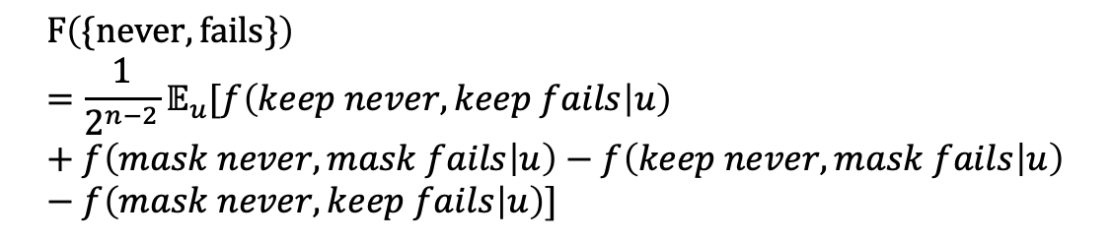
Perturbation-based explanations of LLMs
Thus, the authors introduce the Boolean Fourier transform to expand value function onto an orthogonal basis. The Fourier coefficient for feature interactions indicates their weight in explaining the LLM output.
Fourier coefficient : $F(k)=\frac{1}{2^{n}}\sum_{{m∈\left\{0,1\right\}}^{n}}{ }{\left(−1\right)}^{<m,k>}f(m)$
m is masking pattern; k represents a feature interactions; $<m,k>$is an inner product defined on the Boolean vector space${\left\{0,1\right\}}^{n}$. It is a modulo-2 (XOR) inner product.
Example: Input x=“Her acting never fails to impress”
k={never, fails}
m={0,0,1,1,0,0} is a masking vector
<m,k>=$m_{never}+m_{fails}$
$$F\left(\{never,fails\}\right)=\frac{1}{2^{n−2}}𝔼_{u}[f\left(keep never,keep fails | u\right)+f\left(mask never,mask fails | u\right)−f\left(keep never,mask fails | u\right)−f\left(mask never,keep fails | u\right)]$$
The second-order Fourier coefficient measures the interaction effect between two words — that is, whether their joint occurrence influences the model’s prediction beyond the sum of their individual effects.
Kang J S, Butler L, Agarwal A, et al. Spex: Scaling feature interaction explanations for llms[J]. arXiv preprint arXiv:2502.13870, 2025.

Slide 14
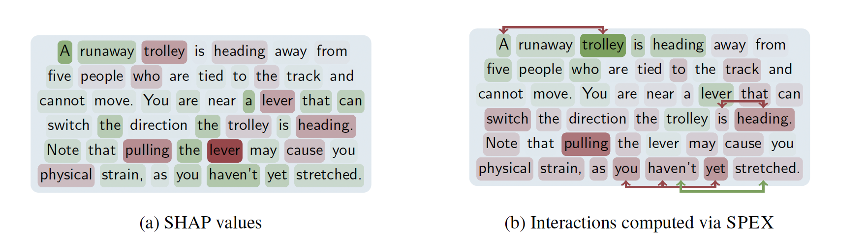
Perturbation-based explanations of LLMs
The authors obtain the Fourier coefficients through an approximate method
Step 1: Determine a minimal set of masking patterns m to use for model inference f(m)
Step 2: Efficiently learn the surrogate function from the set of collected samples f(m)
Setp 3: Use surrogate function and its Fourier transform to identify important interactions
Case study-Debugging Incorrect LLM Responses
A runaway trolley is heading away from five people who are tied to the track and cannot move. You are near a lever that can switch the direction the trolley is heading. Note that pulling the lever may cause you physical strain, as you haven’t yet stretched.
True or False: You should not pull the lever.
Words and interactions highlighted in green contribute positively to producing the correct output, while those in red lead the model toward an incorrect response.
The last sentence have a negative first order value, with a significant third order interaction between you haven't yet in the SPEX method. Removing the non-critical final sentence unexpectedly boosts the model’s accuracy to 20.8%.
Llama 3.2 3B correctly selects the answer True 11.8% of the time.
Kang J S, Butler L, Agarwal A, et al. Spex: Scaling feature interaction explanations for llms[J]. arXiv preprint arXiv:2502.13870, 2025.

Slide 15
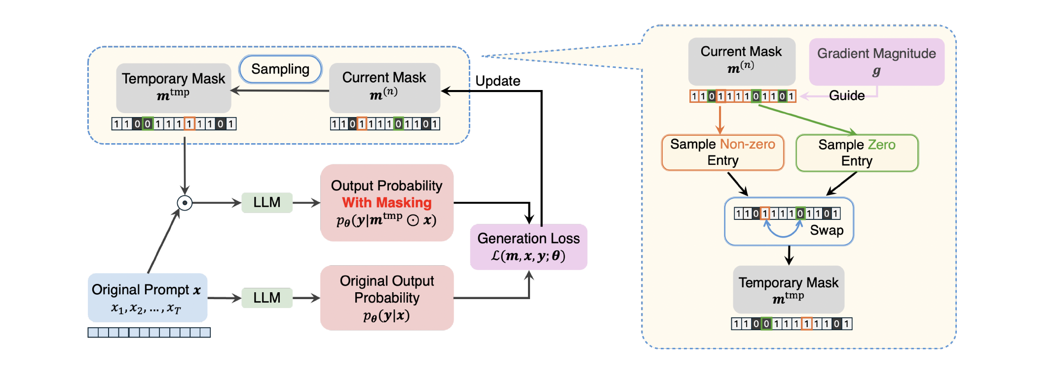
Perturbation-based explanations of LLMs
The authors propose a framework that explains large language model generation by applying masking on prompt tokens. By searching for token subsets whose removal causes the largest change in generation, this paper provides counterfactual explanations
Left: Demonstrating the pipeline of the algorithm
Right: Illustrating the process of mask m sampling
Chang Y, Cao B, Wang Y, et al. JoPA: Explaining Large Language Model’s Generation via Joint Prompt Attribution[C]//Proceedings of the 63rd Annual Meeting of the Association for Computational Linguistics (Volume 1: Long Papers). 2025: 22106-22122.

Slide 16
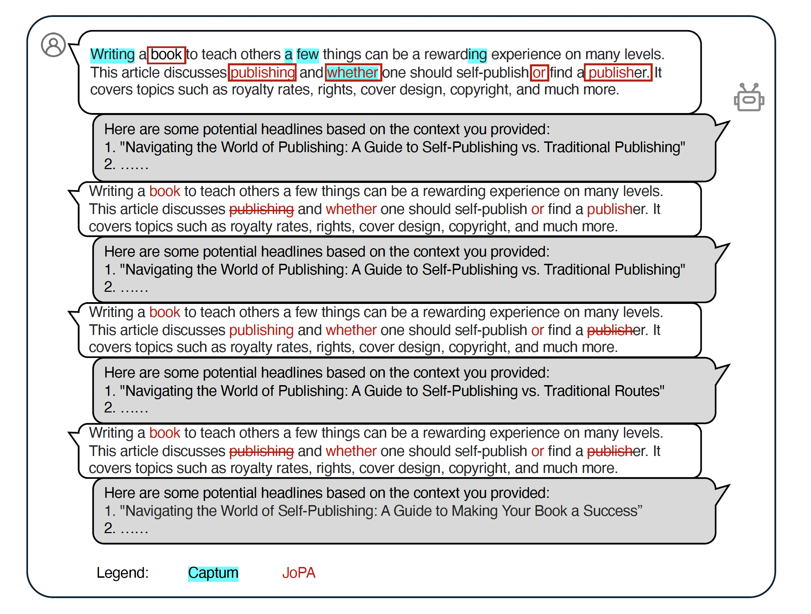
Perturbation-based explanations of LLMs
Case study for visualizing the variation of the model responses after the specific tokens are masked
Compared with the top-k tokens identified by JoPA, those found by Captum are mostly not important to the response.
When masking the token "publishing" or "publish", as identified by JoPA, the generated outputs do not exhibit significant variations in either word frequency or semantics
When masking both tokens "publishing" and "publish", substantial changes in the generated outputs occur
Chang Y, Cao B, Wang Y, et al. JoPA: Explaining Large Language Model’s Generation via Joint Prompt Attribution[C]//Proceedings of the 63rd Annual Meeting of the Association for Computational Linguistics (Volume 1: Long Papers). 2025: 22106-22122.

Slide 17
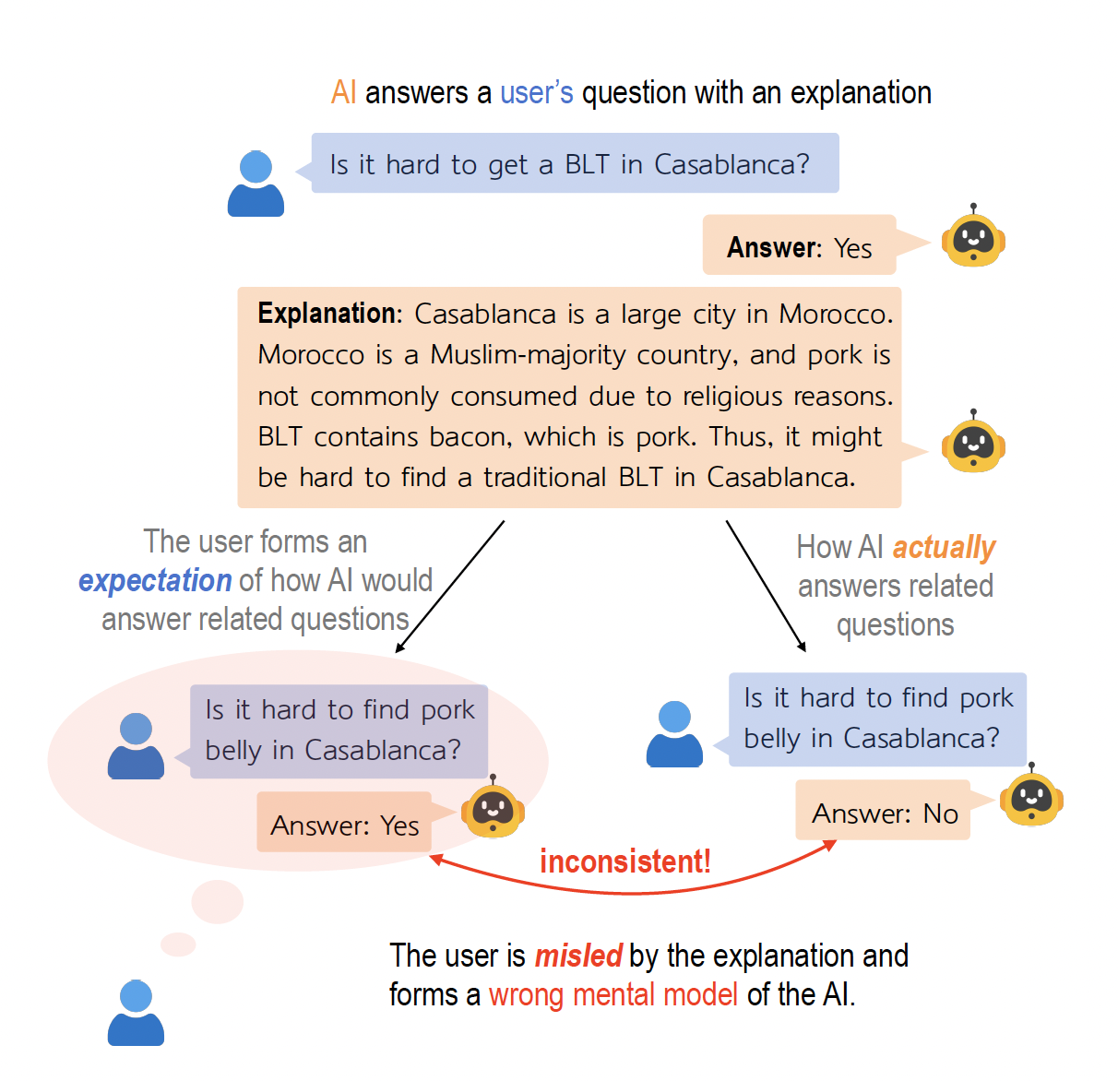
Counterfactual Simulatability of LLM Explanations
The authors evaluate counterfactual simulatability of LLM Explanations
GPT-4 answers a human user’s question and generates an explanation
GPT-4 actually answers (right) is different from what the user would expect (left) based on the explanation
Chen Y, Zhong R, Ri N, et al. Do models explain themselves? counterfactual simulatability of natural language explanations. ICML 2024

Slide 18
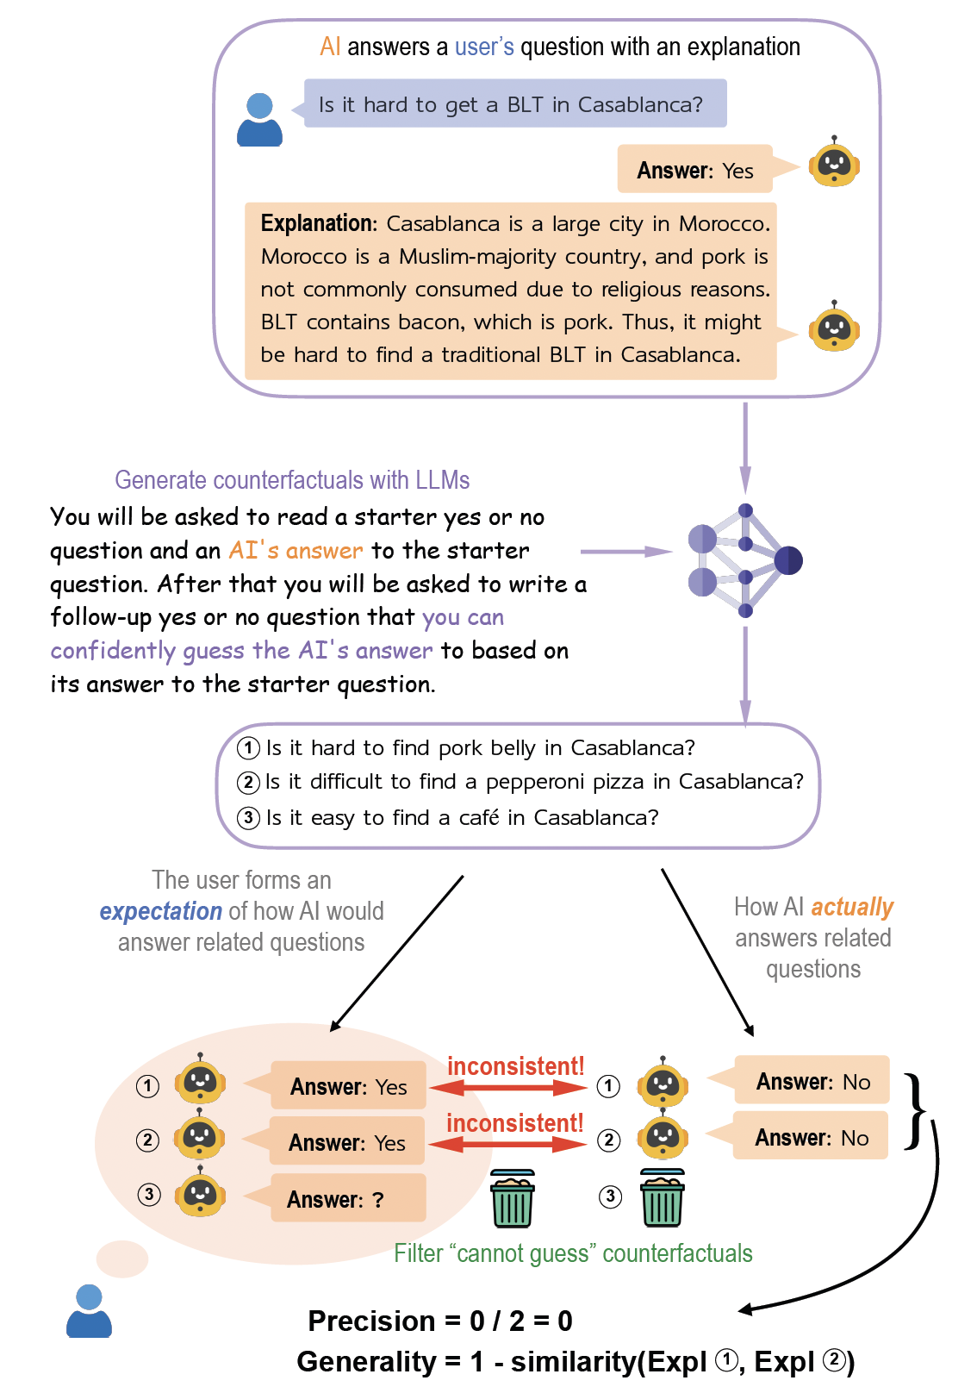
Counterfactual Simulatability of LLM Explanations
Step 1: GPT-4 answers human user's question and explains its decision process
Setp 2: The authors use LLMs to generate related counterfactuals based on the model’s explanation
Step 3: Humans logically infer based on the explanation what GPT-4 outputs for each counterfactual if possible
Step 4: The author ask GPT-4 to answer each counterfactual, calculate simulation precision and generality
Chen Y, Zhong R, Ri N, et al. Do models explain themselves? counterfactual simulatability of natural language explanations. ICML 2024

Slide 19
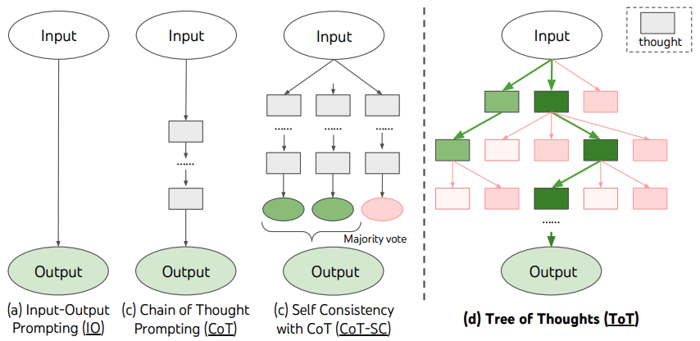
Tree of Thoughts
Chain-of-Thought (CoT): prompts LLMs to generate a sequence of intermediate reasoning steps before producing a final answer.
Pro: easy to understand the reasoning process of LLM (on surface!)
Upgrading LLM’s thinking process from a “linear chain” to a “tree”, giving it the ability to explore, evaluate, and even backtrack.
Yao, Shunyu, etc. Tree of thoughts: Deliberate problem solving with large language models. NeurIPS 2023.
Notes:
No Exploration: Inability to consider multiple possibilities simultaneously.
No Backtracking: Once a wrong step is made, it's difficult to correct, and the only option is to stick with it.
No Lookahead: Inability to assess the long-term impact of current choices on the overall situation.
Generate Multiple "Idea" Branches: At each step, the AI ​​proposes multiple possible next steps (branches of the tree).
Self-Evaluation and Pruning: The AI ​​carefully evaluates the pros and cons of each branch, determining which is most likely to lead to the correct answer.
Systematic Search: Using algorithms (such as breadth-first search and depth-first search) to systematically explore the "idea tree," it can look ahead several steps and return to a previous step to explore a different branch if a path is found to be blocked.

Slide 20
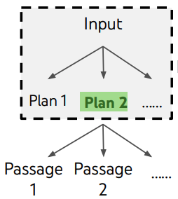
Tree of Thoughts
Thought Decomposition: Break down a complex problem into a series of intermediate steps.
Thought generator:
Sample i.i.d. thoughts from a CoT prompt.
Propose thoughts sequentially.
State evaluator:
LLM values each state independently and gives a score value or classification.
LLM will look at all the generated branches at the same time, compare them, and "vote" to select the best one.
Search algorithm: BFS/DFS
Yao, Shunyu, etc. Tree of thoughts: Deliberate problem solving with large language models. NeurIPS 2023.
Notes:
Example: In the "24-point game," an "idea" is an intermediate operation (e.g., 10-4=6).
2.
Strategy: You can generate multiple ideas independently, or propose a series of complementary ideas in sequence.
Sample : This works better when the thought space is rich (e.g. each thought is a paragraph), and i.i.d. samples lead to diversity;
Propose : This works better when the thought space is more constrained (e.g. each thought is just a word or a line), so proposing different thoughts in the same context avoids duplication.
3.
This is the core innovation of ToT:
LLM evaluates each generated "branch of thought" independently and assigns a score or classification (e.g., "definitely possible/maybe possible/definitely not possible").
When assigning an absolute score to each branch is difficult (such as assessing the "coherence" of an essay), LLM examines all generated branches simultaneously, compares them, and "votes" on the best one.
4.
Breadth-first search (BFS): At each step, retain the most promising options and proceed steadily.
Depth-first search (DFS): Follow the most promising path to the end, returning to another path if it fails.

Slide 21
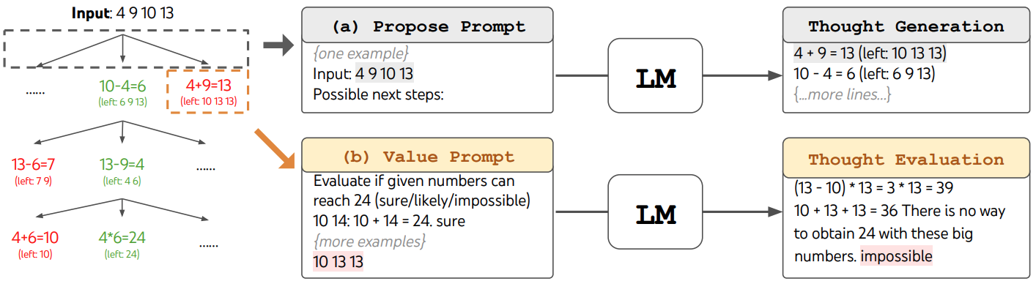
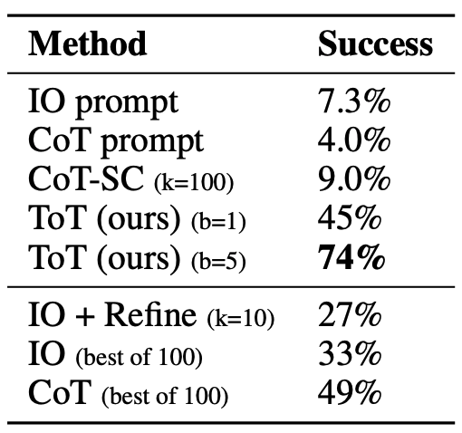
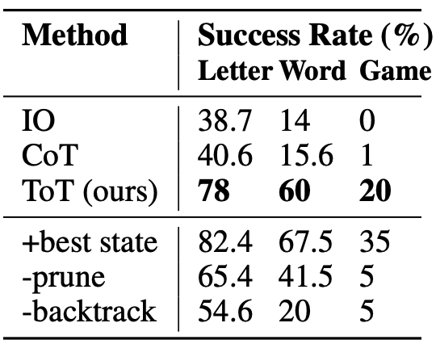
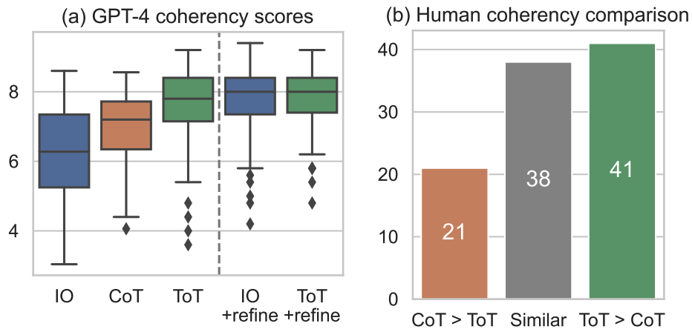
Tree of Thoughts
Game of 24: using 4 numbers and arithmetic operations to get 24.
Creative writing: write a coherent essay by ending each paragraph with four unrelated sentences.
Mini Crosswords: 5 x 5 crossword puzzle.
Yao, Shunyu, etc. Tree of thoughts: Deliberate problem solving with large language models. NeurIPS 2023.
Notes:
game 24) IO, CoT, and CoT-SC prompting methods perform badly on the task,
achieving only 7.3%, 4.0%, and 9.0% success rates. In contrast, ToT with a breadth of b = 1 already
achieves a success rate of 45%, while b = 5 achieves 74%.
Create writing: shows average GPT-4 scores across 100 tasks, where ToT (7.56) is deemed to
generate more coherent passages than IO (6.19) and CoT (6.93) on average. While such an automatic
metric might be noisy, Figure 5(b) confirms the finding by showing that humans prefer ToT over
CoT in 41 out of 100 passage pairs, while only prefer CoT over ToT in 21 (other 38 pairs are found
“similarly coherent”).
IO and CoT prompting methods perform poorly with a word-level success rate less than 16%, while ToT significantly improves all metrics, achieving a word-level success rate of 60% and solving 4 out of 20 games. Such an improvement is not surprising, given IO and CoT lack mechanisms to try different clues, make changes to decisions, or backtrack.

Slide 22
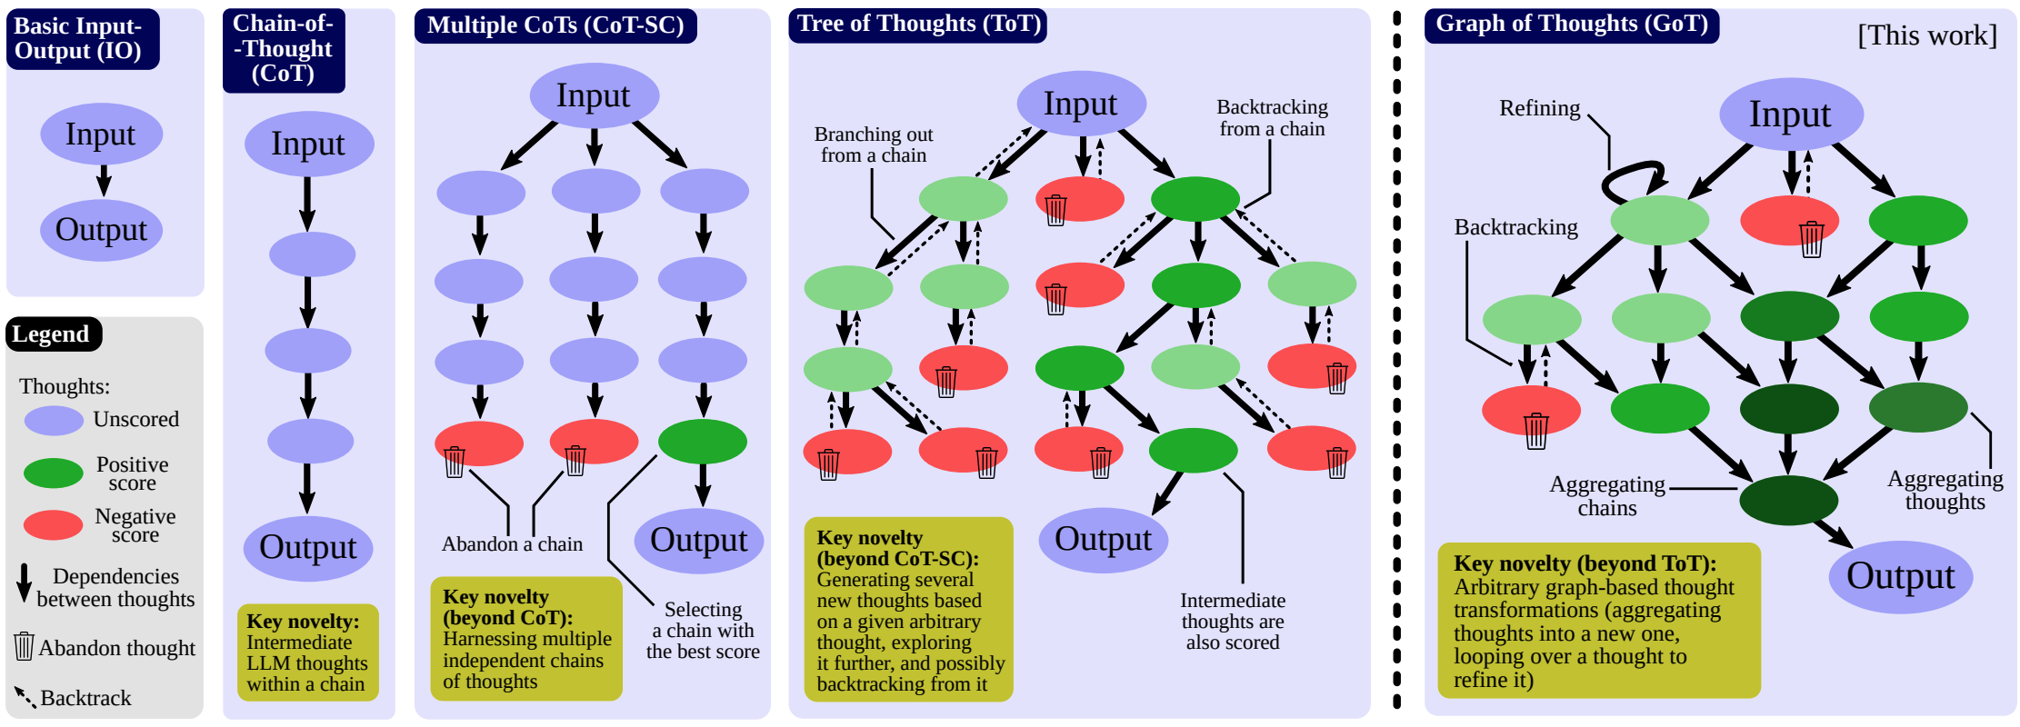
Graph of Thoughts
Graph of Thoughts:
Aggregation: It integrates conclusions from different branches to form a more comprehensive and powerful new idea.
Refinement: It allows for iterative and self-correction of a single idea, deepening thinking.
Image Source: https://demogpt.medium.com/graph-of-thoughts-solving-elaborate-problems-with-large-language-models-78985558345

Slide 23
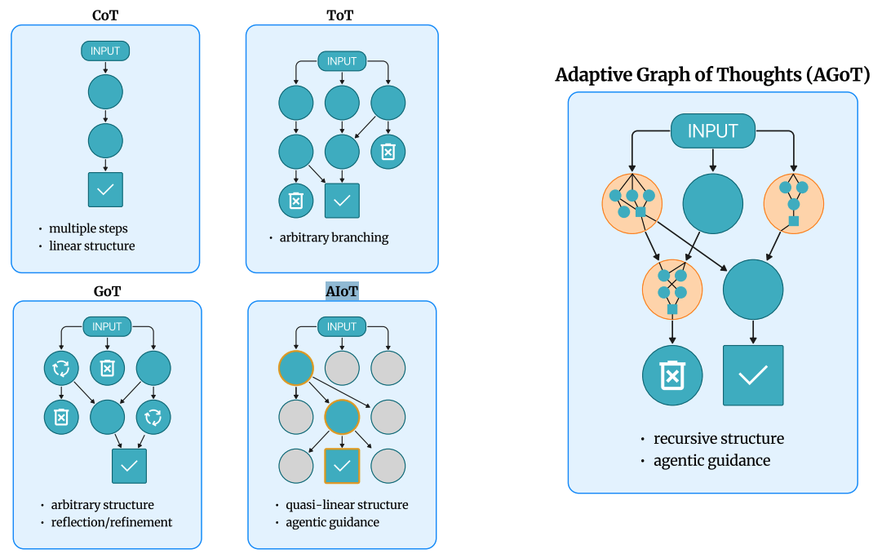
Adaptive Graph of Thoughts
Ideas:
Instead of using a fixed structure, a model dynamically builds a reasoning graph as it solves a problem.
The model ​​will determine which parts of the problem are "complex" and devote more computing resources only to these complex parts.
Tushar, etc. Adaptive graph of thoughts: Test-time adaptive reasoning unifying chain, tree, and graph structures. arXiv preprint arXiv:2502.05078 (2025).
Notes:
Dynamic Decomposition: Automatically decomposes complex problems into interdependent subproblems.
Recursive Structure: If a subproblem is inherently complex, AGoT will initiate a new, nested thought map to solve it.

Slide 24
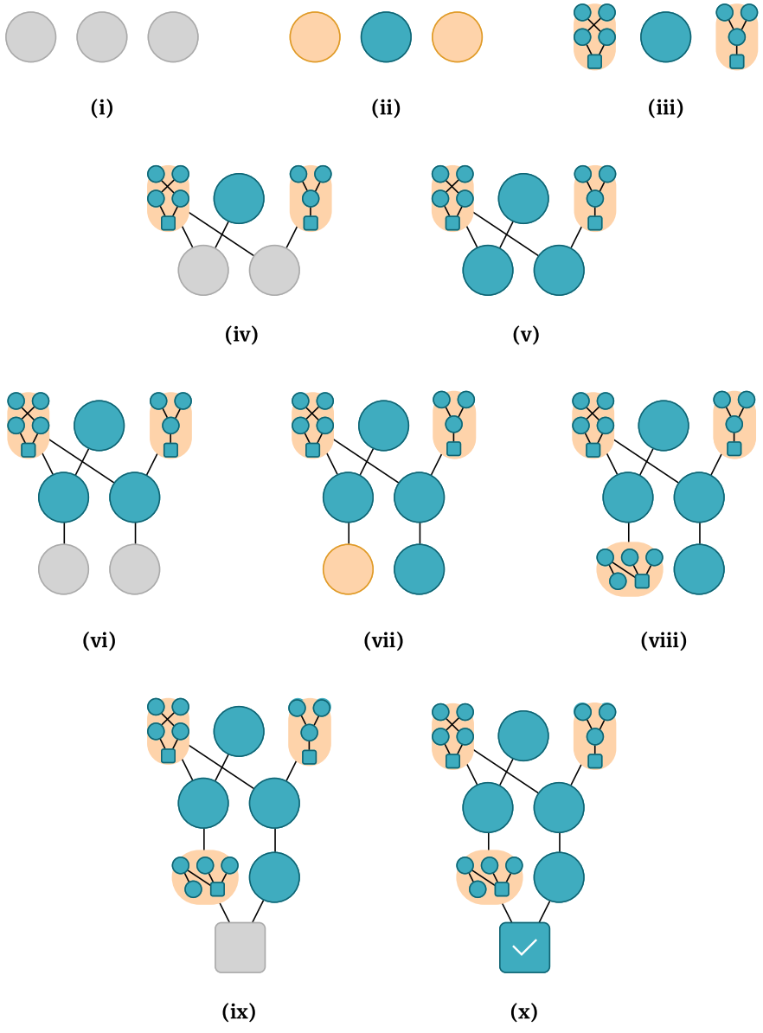
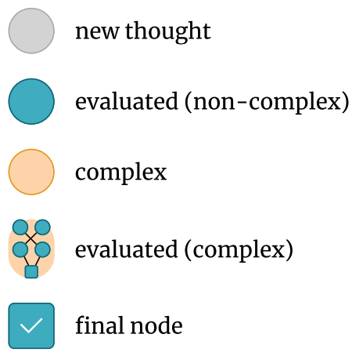
Adaptive Graph of Thoughts
Thought structures as graphs:
Layer 1:
step (i): generate some init thoughts.
step (ii): if non-complex: become blue; else, the node needs decompose.
step (iii): For complex thoughts, a new AGoT process start.
Layer 2:
step (iv): generate new thoughts based on evaluated thoughts.
step (v): eval new thoughts.
···
Layer 4:
step (ix): generate a thought.
step (x): eval the thought as a final thought.
Tushar, etc. Adaptive graph of thoughts: Test-time adaptive reasoning unifying chain, tree, and graph structures. arXiv preprint arXiv:2502.05078 (2025).
Notes:
Dynamic Decomposition: Automatically decomposes complex problems into interdependent subproblems.
Recursive Structure: If a subproblem is inherently complex, AGoT will initiate a new, nested thought map to solve it.

Slide 25
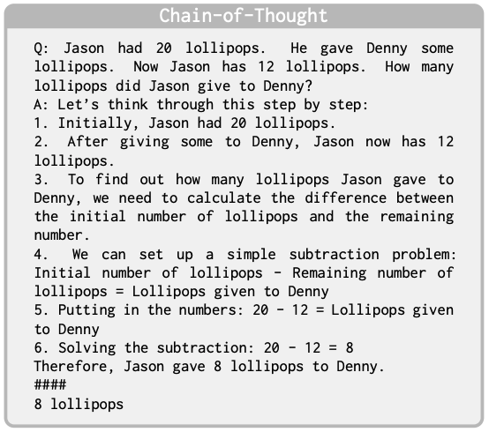
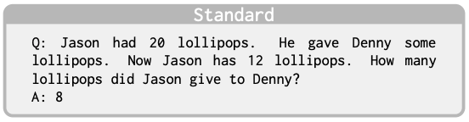
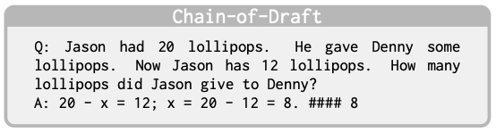
Chain of Draft
The deeper you think, the greater the cost
When humans solve complex problems, we don’t write down complete sentences in our heads or on paper.
Instead, we “rough drafts” using concise notes, key symbols, or equations to capture only the most essential information.
Force the model ​​to generate extremely short, information-dense intermediate outputs (“drafts”) at each step of reasoning, rather than complete sentences.
Xu, Silei, et al. "Chain of draft: Thinking faster by writing less." arXiv preprint arXiv:2502.18600 (2025).
Notes:
The CoT (CoT) and its subsequent developments (such as ToT and GoT) have greatly improved AI reasoning capabilities.
Common Tradeoffs: These approaches encourage AI to generate lengthy and detailed intermediate steps, resulting in:
High Latency: Generating large amounts of text takes a long time.
High Cost: Significant token consumption and expensive API calls.
Unnatural: This is fundamentally different from how humans solve problems.

Slide 26
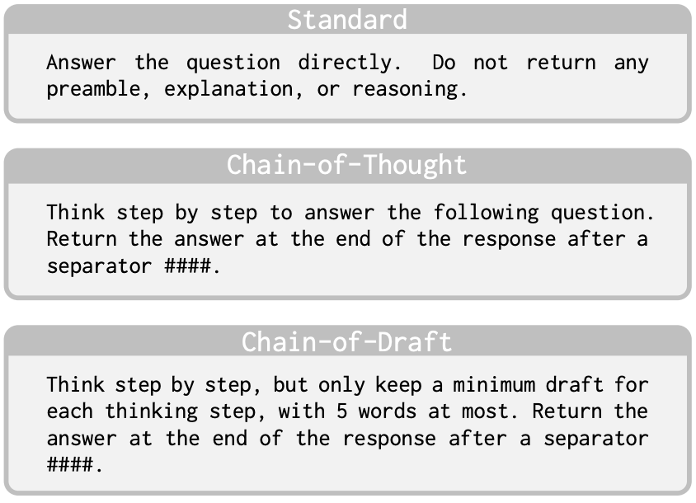
Chain of Draft
LLM is required to simplify each step of the reasoning process, retaining only key information (such as formulas, symbols, values, etc.), and each step should not exceed 5 words (soft constraints, not necessarily required)
Prompt setting:
Xu, Silei, et al. "Chain of draft: Thinking faster by writing less." arXiv preprint arXiv:2502.18600 (2025).

Slide 27
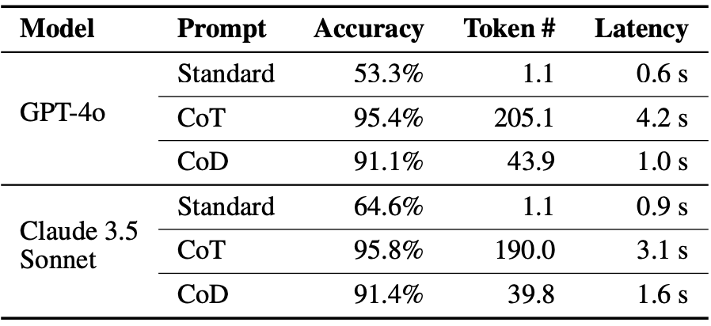
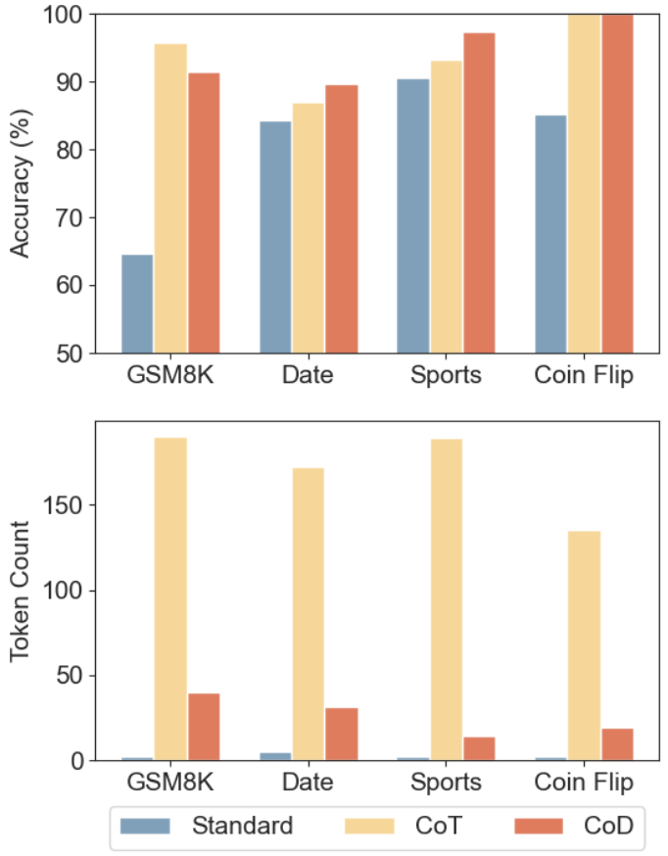
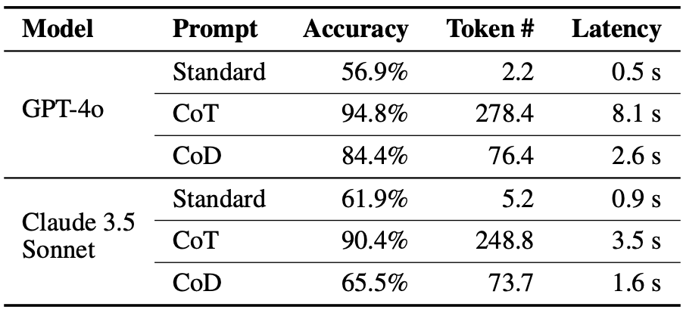
Chain of Draft
Experiment:
Comparison of Claude 3.5 Sonnets accuracy and token usage across different tasks with three different prompt strategies.
GSM8K evaluation results.
faster
Zero-shot GSM8K evaluation results.
drop too much!
Xu, Silei, et al. "Chain of draft: Thinking faster by writing less." arXiv preprint arXiv:2502.18600 (2025).
Notes:
Comparison of Claude 3.5 Sonnets accuracy and token usage across different tasks with three
different prompt strategies: direct answer (Standard),
Chain of Thought (CoT), and Chain of Draft (CoD). CoD achieves similar accuracy as CoT while using significant fewer tokens.
, CoD achieves an accuracy of 91% for both models while requiring only about 40 tokens per response, thereby reducing the average output token count by 80% and
cutting the average latency by 76.2% and 48.4%, respectively.
The CoD method's accuracy is significantly lower than the CoT method, indicating that the CoD method requires a few-shot approach to maintain high accuracy.
Possible cause: The model may lack similar CoD training data in its previous training data, resulting in inference failures that fail to fully adhere to the CoD inference method, ultimately leading to decreased accuracy.

Slide 28
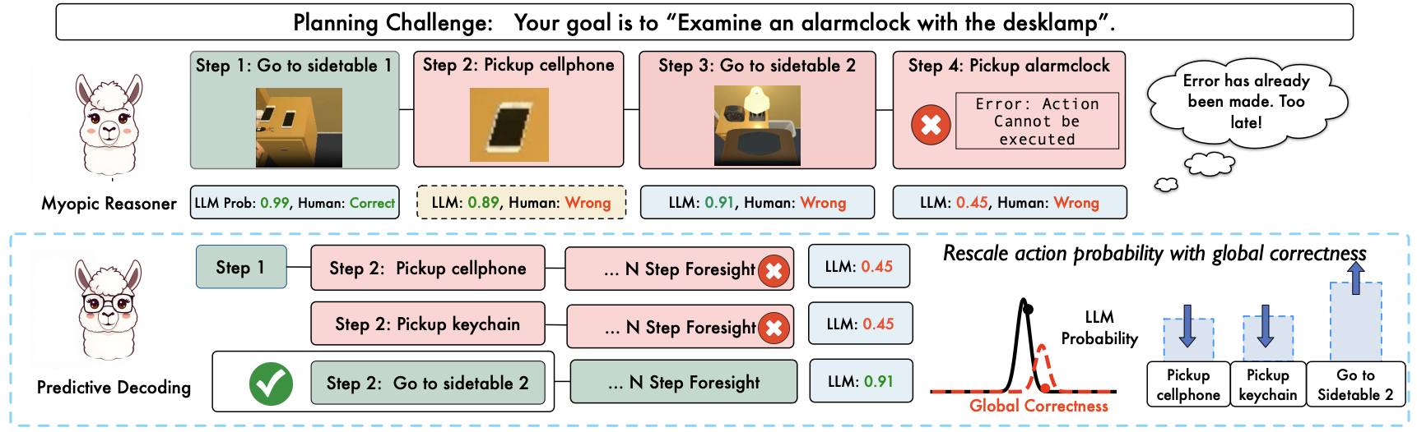
Non-myopic Generation
Myopia
Autoregressive decoding is the core mechanism of all large language models, which may choose a locally optimal step early on, but this step can lead to an irreversible dead end.
A good model foresees and evaluates the impact of a decision on all possible future scenarios.
Ma, Chang, et al. "Non-myopic Generation of Language Models for Reasoning and Planning." ICLR.
Notes:
LLM autoregressive planning often suffers from near sight. Predictive-Decoding rescales LLM generation distribution based on evaluation of foresight, enabling non-myopic planning.
This mechanism is inherently shortsighted. The AI ​​may choose a locally optimal step early on, but this step can lead the entire reasoning process to an irreversible dead end.
Model Predictive Control (MPC): This is a classic engineering control theory. Its core principle is to simulate and predict the future at every decision step, and then select the current action that will yield the best long-term returns.

Slide 29
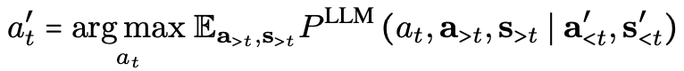
Non-myopic Generation
Objective:
Predictive-Decoding:
Sample Foresight Trajectories:
Generate K short-range "future trajectories" of fixed length in parallel.
Evaluate Foresight Trajectories:
LLM Self-Evaluation: Calculate the total probability of LLM generating a trajectory as a score.
Employ human-designed reward heuristics.
External Reward Model: use Math-Shepherd^{[1]} as the reward model for GSM8K.
Reweight & Resample:
LLM will readjust the probability distribution of all possible first-step actions based on the evaluation weight of the previous step.
[1] Peiyi Wang, et.. Math-shepherd: A label-free step-by-step verifier for llms in mathematical reasoning. arXiv preprint arXiv:2312.08935, 2023b.
[2] Ma, Chang, et al. "Non-myopic Generation of Language Models for Reasoning and Planning." ICLR.
Notes:
objective: LLMs could accurately evaluate future steps after incorporating a
few steps of foresight.
we evaluate the future constrained to T0 steps of foresight, i.e. a>t ∶= at+1∶t+T0
The objective function is the expectation E taken over all possible future action sequences (a_{>t}) and their resulting states (s_{>t}).
This expectation is calculated on P^LLM(...), which represents the language model's assigned probability to a full trajectory composed of the candidate action a_t and its subsequent future rollout, all conditioned on the previously executed history (a'_{<t}, s'_{<t}).
.

Slide 30
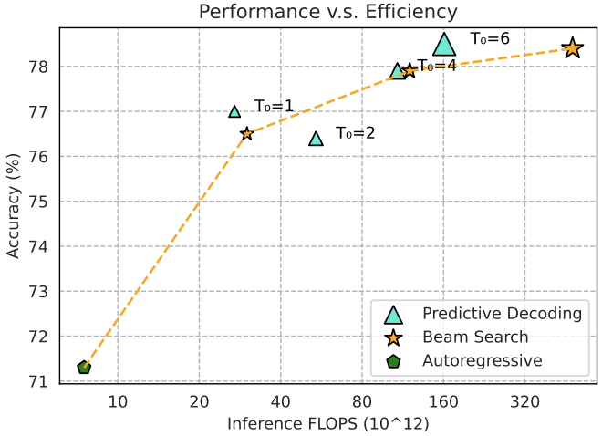
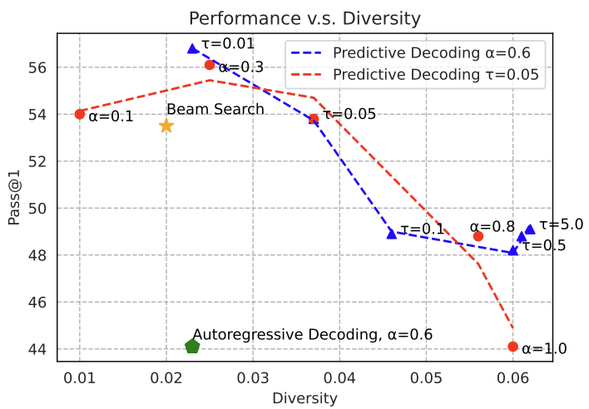
Non-myopic Generation
T₀ is the length of Foresight
A higher α increases the stochasticity of candidate path generation.
A higher τ increases the smoothness of the probability distribution over evaluated trajectories.
Ma, Chang, et al. "Non-myopic Generation of Language Models for Reasoning and Planning." ICLR.
Notes:
A higher α increases the stochasticity of candidate path generation, thereby enhancing the diversity of the exploration space.
A higher τ increases the smoothness of the probability distribution over evaluated trajectories, thereby promoting the exploration of suboptimal paths.

Slide 31
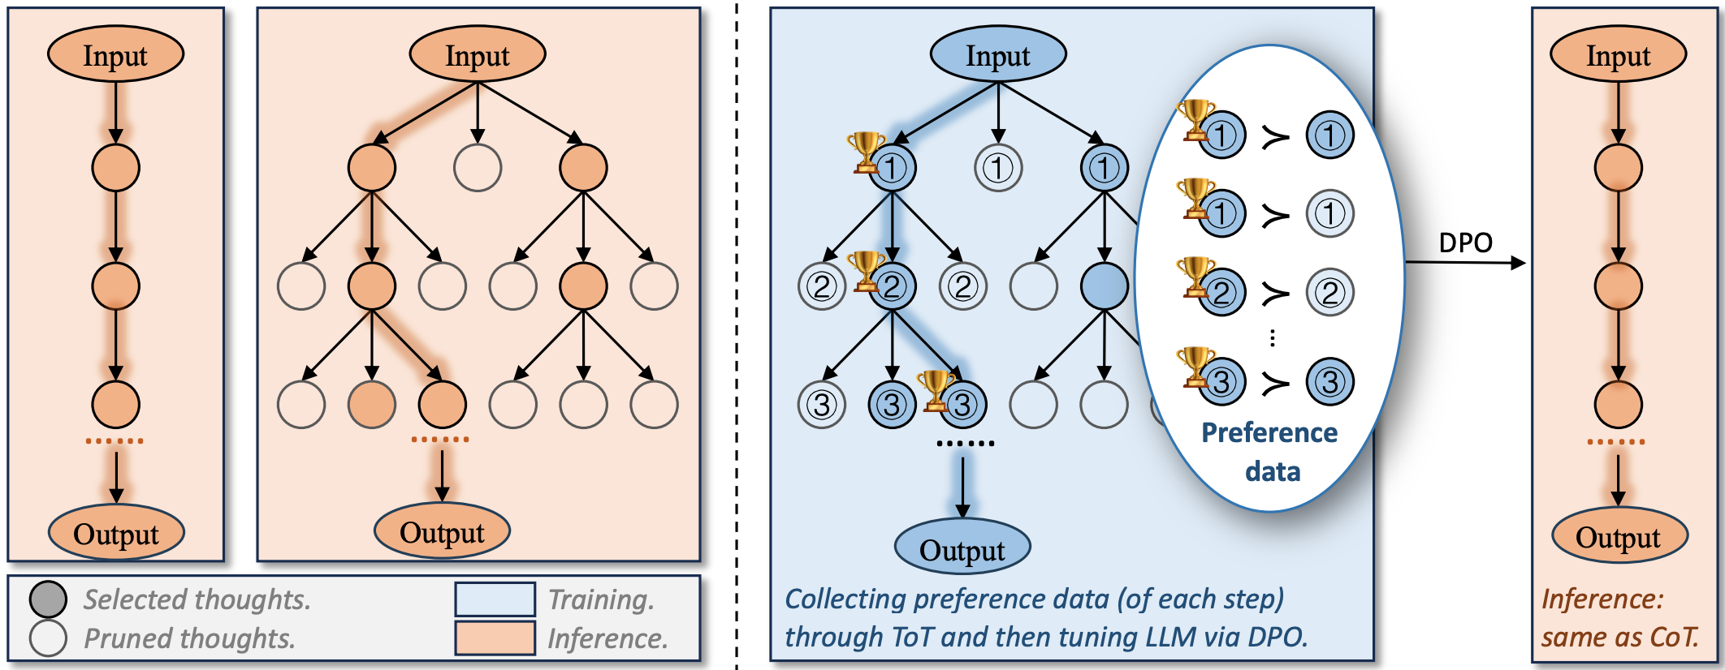
Chain of Preference Optimization
CoT: overlook optimal reasoning paths.
ToT: increased computational complexity.
Can the strategic depth of ToT be integrated into CoT to enhance its effectiveness while maintaining efficiency? Step-wise preference supervision
Zhang, Xuan, et al. “Chain of preference optimization: Improving chain-of-thought reasoning in llms.” NeurIPS 2024.
Notes:
Limitation: previous works overlook the non-optimal reasoning thoughts generated during the tree-search process, which naturally provides additional preference information.
construct paired preference thoughts at each reasoning step according to the search tree of ToT and then train LLMs to align with these preferences using the dpo.

Slide 32
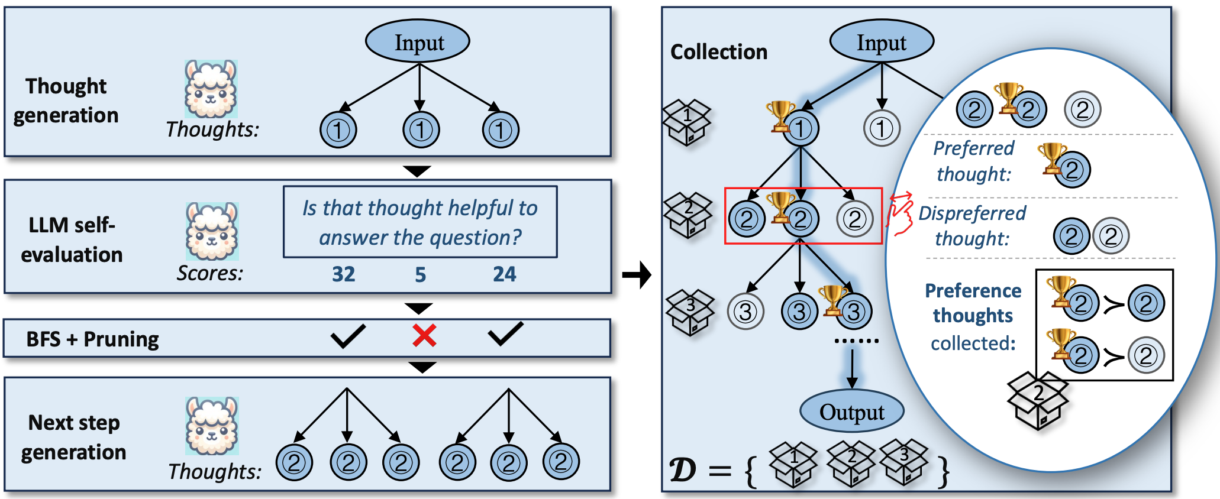
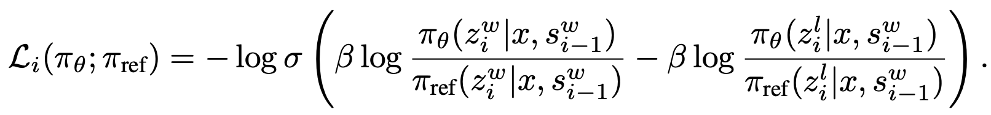
Chain of Preference Optimization
The process of generating, evaluating, and pruning thoughts
The collection of preference thoughts
Given previous winning steps,
prefer the next winning step.
Zhang, Xuan, et al. “Chain of preference optimization: Improving chain-of-thought reasoning in llms.” NeurIPS 2024.
Notes:
Left:
1) thought generation, which generates multiple thoughts for each reasoning step;
2) state evaluation, which evaluates each thought;
3) pruning thoughts with low score
Right:
Thoughts appearing in the best-discovered reasoning path hshould be prefered over those that do not.
Train with the cpo objectuve:

Slide 33
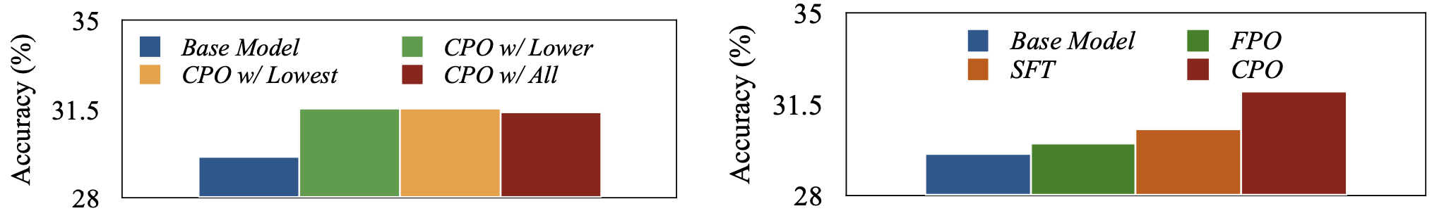
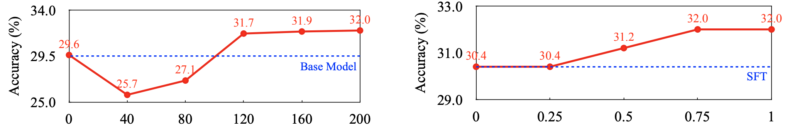
Chain of Preference Optimization
Effect of dispreferred thoughts selection
Effect of per-step preference supervision
Effect of the number of instances in generating paired thoughts.
Effect of dispreferred thoughts in optimization.
Zhang, Xuan, et al. “Chain of preference optimization: Improving chain-of-thought reasoning in llms.” NeurIPS 2024.
Notes:
1. Base Model: The base LLM. CPO w/ Lowest: CPO using the lowest-scoring thoughts as dispreferred. CPO
w/ Lower: CPO using all lower-scoring thoughts as dispreferred. CPO w/ All: CPO using all thoughts
not in the selected paths as dispreferred.
The performance differences brought by these three strategies are negligible, which shows that the key to the success of CPO lies in allowing the model to learn to distinguish between "selected" and "unselected" ideas, and the specific selection of "bad examples" has little impact.
2. Base Model: The LLM without any fine-tuning. SFT: SFT of the base LLM (i.e., our TS-SFT baseline). FPO:
DPO of the base LLM on paired full paths. CPO: CPO of the base LLM on paired per-step thoughts
CPO significantly outperforms the other two, while FPO is even worse than SFT. This strongly proves that providing granular, step-by-step preference guidance is crucial, which allows the model to learn to make better choices at each step of reasoning.
3. The number indicates the number of instances (e.g., questions in the QA task) used to generate paired thoughts for our CPO.
when the number of original questions is too small (<80), model performance decreases due to overfitting; however, when the number increases to around 120, performance reaches a peak and stabilizes. This result shows that CPO does not require a large amount of initial data to generate a sufficiently effective training set, and has high data efficiency.
4. The percentage indicates the proportion of data used for CPO, which uses dispreferred thoughts.
As the proportion of CPO data increases, the model accuracy steadily improves.

Slide 34
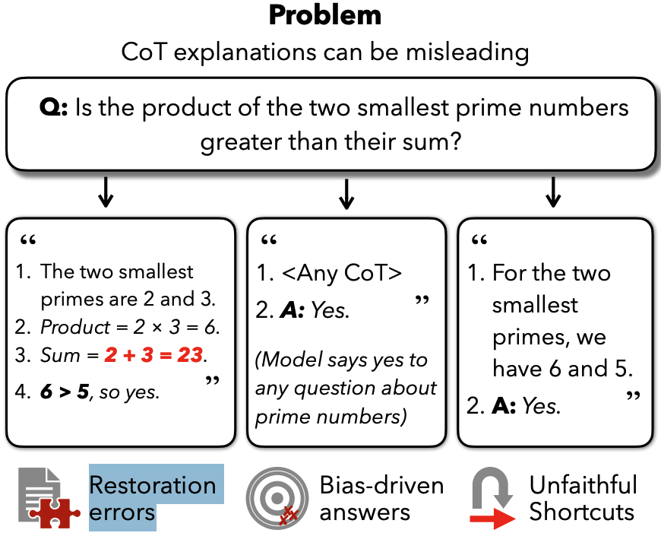
Chain-of-Thought Is Not Explainability
Unfaithfulness
Restoration errors: Model presents a reasoning chain with a clear mistake, yet it still reaches the correct final answer.
Bias-driven answers: Model is predetermined by a hidden bias to agree with certain types of questions.
Unfaithful Shortcuts: Model skips essential calculation steps in its reasoning, suggesting it employed a latent, more direct method to arrive at the result that was not verbalized.
Barez, Fazl, et al. "Chain-of-thought is not explainability." Preprint, alphaXiv (2025): v2.
Notes:
1. the reasoning chains generated by large language models (LLMs) through Chain-of-Thought (CoT) prompting, while beneficial for task performance, are not a reliable form of explainability.

Slide 35
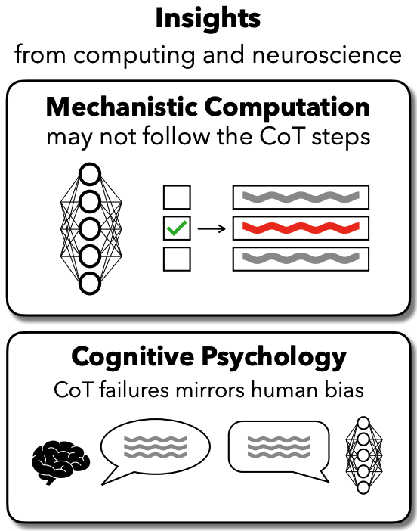
Chain-of-Thought Is Not Explainability
High-level Reasons
A model's internal processing is parallel and distributed, which may not follow the linear, step-by-step format presented in a CoT.
Verbalized rationales often serve to justify a decision post-hoc rather than describe the actual reasoning process.
Barez, Fazl, et al. "Chain-of-thought is not explainability." Preprint, alphaXiv (2025): v2.
Notes:
Internal AI: Highly parallel, distributed, complex network computing.
External CoT: Linear, single-path textual description.
Conclusion: Using simple, linear text to describe complex parallel computing is inherently a lossy and incomplete projection.
Cognitive Parallels
This is similar to human cognitive biases: people often provide post-hoc, logical explanations for their intuitive decisions.

Slide 36
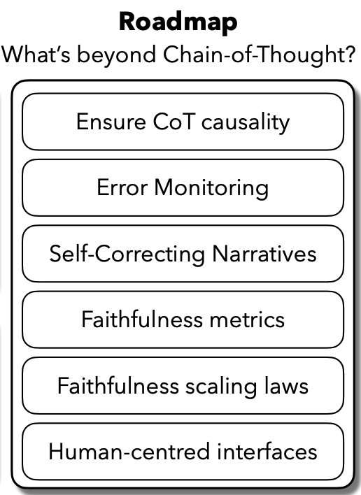
Chain-of-Thought Is Not Explainability
What’s next?
Ensure Causality: Develop methods to verify that each step in the CoT has a true causal impact on the final answer. Need Explainable LLM techniques!
Introduce Cognitive-Inspired Methods: Train AI to develop metacognitive capabilities, such as self-error monitoring and generating self-correcting reasoning narratives. Need LLM Uncertainty Quantification techniques!
Enhance Human Oversight: Develop more effective interactive interfaces that allow users to explore, challenge, and verify AI reasoning steps, and establish standardized “fidelity” metrics. Need Explainable LLM techniques!
Barez, Fazl, et al. "Chain-of-thought is not explainability." Preprint, alphaXiv (2025): v2.

Slide 37
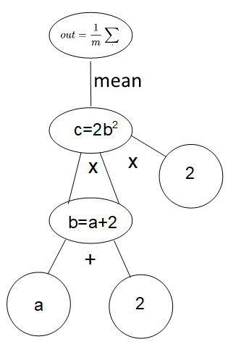
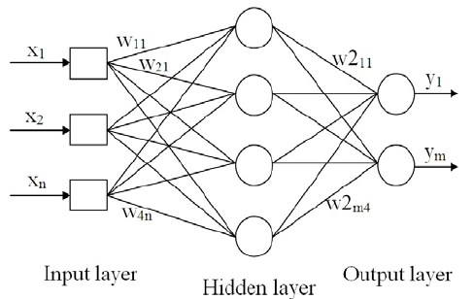
Mechanical interpretation
Computational graphs
A DAG (directed acyclic graph): nodes = data, directed edge = input
Represent the flow of data through ordered operations.
z=x+y
out=mean(2(a+2)²)
y=softmax(W₂(sigmoid(W₁ x))
Fine-granularity: a lot of details.
z
x
y
Coarse-granularity: easier to understand
T=sigmoid
(W₁ x)
y=softmax
(W₂ T)
x

Slide 38
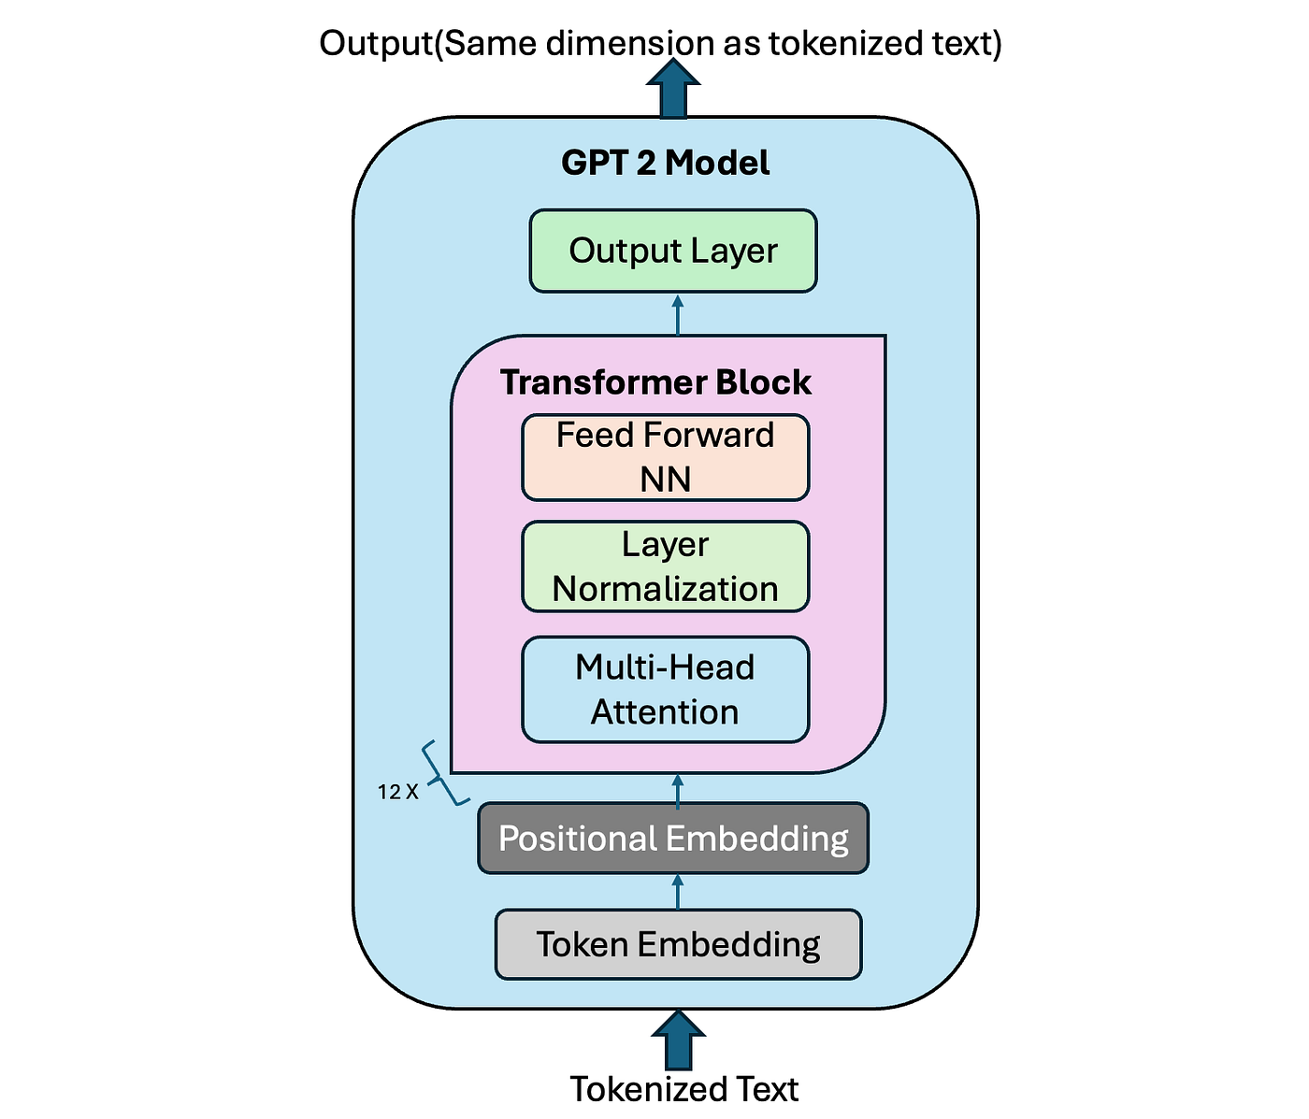
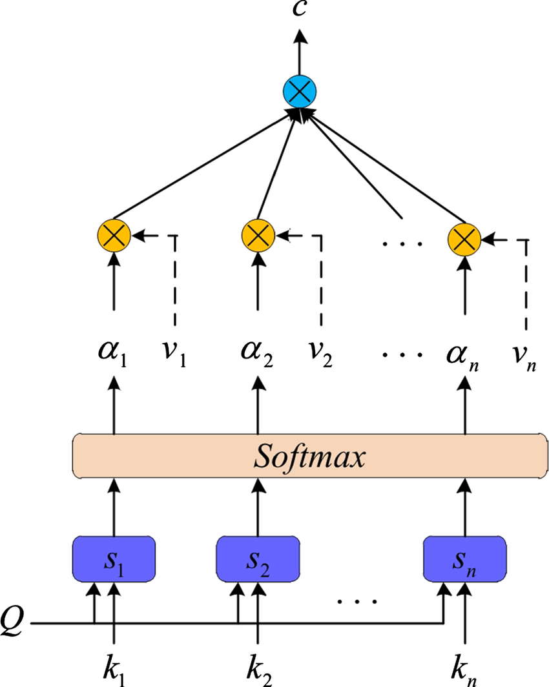
Mechanical interpretation
Transformer’s computational graph
MLP<i>: the MLP layer at
the i-th Transformer block
A<i>H<j>: the j-th self-attention head
at the i-th Transformer block for one token
x=sigmoid(t)
t=W₂t
t=sigmoid(t)
t=W₁x
This is the architecture of Transformer, not its computational graph.
x=LN(cat(c₁,…,c_{nh}))
12 x 12 attention heads for GPT2.
12 MLP for GPT2.
Liu X, Yang N, Jiang Y, et al. A parallel computing-based Deep Attention model for named entity recognition[J]. Journal of supercomputing, 2020, 76(2).
Image source: https://medium.com/@vipul.koti333/from-theory-to-code-step-by-step-implementation-and-code-breakdown-of-gpt-2-model-7bde8d5cecda

Slide 39


Circuit discovery: data and metrics
Find a sub-computational graph to mimic the full one^{[1,2]}
Dataset and prediction tasks
Indirect Object Identification (IOI) ^{[3]}:
Input=“When Mary and John went to the store, John gave a bottle of milk to”
Output=“John” <at the END position>
Greater-than:
Metrics
The logit of the valid target token.
The ranking of the valid target token.
HIT@10: truth included in the top 10 positions?^{[4]}
[1] Chen, etc. Scalable Explanation of Inferences on Large Graphs. ICDM 2019.
[2] Liu, etc. Shapley Values and Meta-Explanations for Probabilistic Graphical Model Inference. CIKM 2020.
[3] Wang, etc. Interpretability in the wild: a circuit for indirect object identification in GPT-2 small. ICLR 2023.
[4] Conmy, etc. Towards Automated Circuit Discovery for Mechanistic Interpretability. NeurIPS 2023.

Slide 40
Circuit discovery
Running example
Search algorithm （sketch)
Topology-sort the nodes on G from output to input;
for each node u and each of its parent v;
evaluate the effect of removing v;
If OK, remove (u,v) from G;
return G;
z=x+y+t
z
More details:
2. 1) Removing (u,v): it is equivalent to setting input v to u to some baseline values, so that v won’t influence u (which can have inputs from other parents). Baseline to be specified in the next slide.
2. 2) OK: output of G and G\(u,v) are similar based on some metric (KL divergence or prediction loss^{[2]}).
x
y
t
x=100, y=1, t=0.1
If remove x=100, z=1.1, loss=100
If remove y=1, z=100.1, loss=1
If remove t=0.1, z=101, loss=0.1
Keep loss < 10, so remove y and t
[1] Hanna, etc. How does GPT-2 compute greater-than?: Interpreting mathematical abilities in a pre-trained language model. NeurIPS 2023.
[2] Yao, etc. Knowledge Circuits in Pretrained Transformers. NeurIPS 2024.

Slide 41

Circuit discovery: tools
Knock-out (or ablation)
set the input to v from u to zero
cons: cause out-of-distribution samples, and the change in logits can be overestimated.
Patching^{[2]}
set the input to v from u to value given by perturbed data.
cons: need perturbed data and another forward pass of the transformer.
Example
Perturbed data: change 1732 to 1701, do another forward pass
(MLP10, Logits) is patched.
[1] Hanna, etc. How does GPT-2 compute greater-than?: Interpreting mathematical abilities in a pre-trained language model. NeurIPS 2023.
[2] Vig, etc. Investigating gender bias in language models using causal mediation analysis. NeurIPS 2020.

Slide 42

Circuit discovery: tools
Want to understand what each internal nodes (Attn or MLP) are outputing.
Attention maps focus on where to gather information.
The un-embedding matrix W_{U} of transformer at the output layers
Turns a latent vector (dim=d) to logits of all tokens in vocab.
Can be used in internal layers too! But why?
Observation: some tokens are predicted earlier than in the last layer^{[1][2]}.
[1] Nostalgebrist. interpreting GPT: the logit lens, 2020
[2] Yao, etc. Knowledge Circuits in Pretrained Transformers. NeurIPS 2024.
[3] Universal Transformer.

Slide 43



Circuit discovery: semantics
Attention maps of A7H11 and A8H10
on the Greater-than task: XX2 attends to YY
Logit lens: translate the output of attention heads to vocab space (A7H10 and A8H11).
(MLP11, MLP10, MLP9, MLP8).
perform the greater-than prediction indicated by the upper triangle pattern. (rows: YY values; columns: predicted values).
[1] Hanna, etc. How does GPT-2 compute greater-than?: Interpreting mathematical abilities in a pretrained language model. NeurIPS 2023.

Slide 44

Circuit: more functional circuits
Name Mover Heads: copy name to another location.
Negative Name Mover Heads:
Backup Name Mover Heads S-Inhibition Heads
Duplicate Heads Previous Token Heads
Induction Heads
A hypothesized algorithm implemented by the extracted circuit^{[1]}:
Wang, etc. Interpretability in the wild: a circuit for indirect object identification in GPT-2 small. ICLR 2023.

Slide 45

Circuit: (negative) name mover head
Using the idea of Logit Lens, unembed each head to W_{U}[IO]-W_{U}[S], W_{U} unembedding matrix mapping from latent vectors to token logits.
Mover: first attends to the name (IO or S), then computes a vector aligned with W[IO]-W[S].
Copy score: among all sample input, how often the head attend to the IO or S.
Wang, etc. Interpretability in the wild: a circuit for indirect object identification in GPT-2 small. ICLR 2023.

Slide 46

Circuit: S-inhibition heads
Given the behavior of Name Mover Heads,
What make them attend to IO rather than other names?
Patching all other heads at the END location using perturbed input.
Note at the each location, there are always 12 x 12 = 144 attention heads.
Observation:with patching certain heads (7.3, 7.9, 8.6, 8.10), attention to IO at END decreases.
Wang, etc. Interpretability in the wild: a circuit for indirect object identification in GPT-2 small. ICLR 2023.

Slide 47
Final comments
Given Bengio’s paper “Chain-of-thought is not explainability” and the long-standing and broad Responsibility issues of LLM, explainability will be a very long-lasting research questions.
In fact, explainability of AI has been there since 1975, regardless of models.
As LLMs are used in many critical domains, its explainability will only become more and more important.
Thinking about finance, medicine, biology, industry design, and many others!
When LLMs are used in a composite system, such as agentic system or embodied AI, its responsibility is clearly necessary.

